Slide 1
Computer Graphics Unit 1 # Introduction of Computer Graphics

Slide 2
1. Introduction to Computer Graphics
Computer Graphics is a field related to the generation of graphics using computers.
Computer graphics are graphics created using computers and the representation of image data by a computer specifically with help from specialized graphic hardware and software.
It includes the creation, storage, and manipulation of images of objects .
These objects come from diverse fields such as physical, mathematical, engineering, architectural, abstract structures and natural phenomenon. obviously know it is open it out is the nearest and we're doing well

Slide 3
2. Application Of Computer Graphics
Computer Aided Design (CAD)
Presentation Graphics
Computer Art
Entertainment
Education and Training
Visualization
Image Processing
Graphical User Interfaces (GUI‟s)
Simulation
Cartography

Slide 4
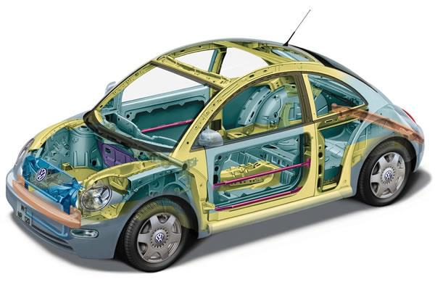
1. Computer Aided Design (CAD)
In CAD, graphics is used to design components and systems of mechanical, electrical, electro-mechanical and electronic devices including structures such as buildings, automobile bodies, airplane, VLSI chips, optical systems and telephone and computer networks.
Objects are displayed in wireframe outline that shows the overall shape and internal features of objects.

Slide 5
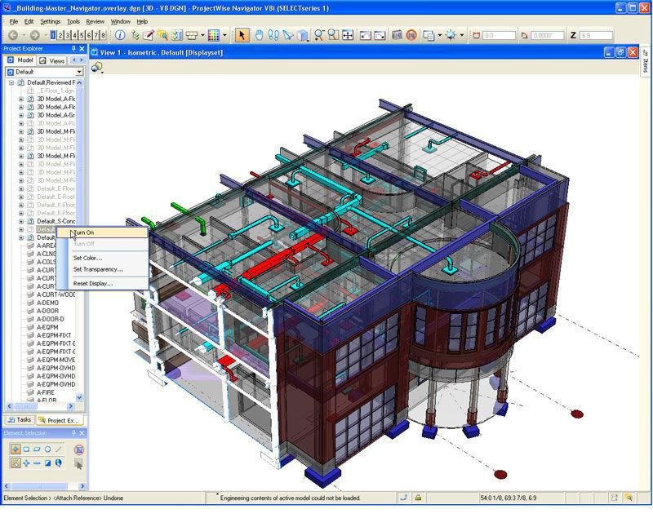
• Architects use computer graphics to layout floor plans that shows positioning of rooms, doors, windows, stairs, shelves and other building features. Electrical designers then try out arrangements for wiring, electrical outlets and other system to determine space utilization on a building.

Slide 6
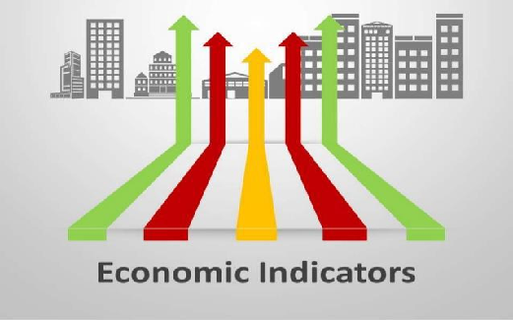
2. Presentation Graphics
Presentation Graphics is commonly used to summarize financial, statistical, mathematical, scientific and economic data for research reports, managerial reports and other types of reports.

Slide 7
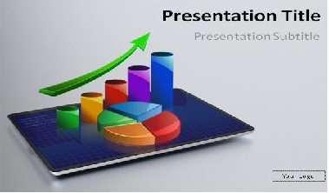
Typical examples are bar charts, line graphs, surface graphs, pie charts and other displays showing relationship between multiple variables

Slide 8

3. Computer Art
Computer graphics is used to generate arts.
Mathematics packages, CAD packages, desktop publishing software and animation packages providing facilities.

Slide 9
4.Entertainment and Gaming
Computer graphics methods are now commonly used in making motion pictures, music videos and TV shows.
Images are drawn in wire-frame form and will be shaded with rendering methods to produce solid surfaces. Music videos use graphics in several ways.

Slide 10
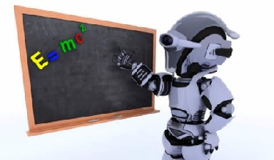
5. Education and Training
Computer graphics is used in education and training for making it more effective and more illustrative.
Computer generated models of physical, financial, and economic systems are often used as educational aids. A student can learn surgery using data gloves and realistic computer graphics.

Slide 11
6. Visualization
• Visualization is the process of visually representing the data. To visualize large amount of information graphical computer systems are used.
• Some methods generate very large amount of data/information, analysis the property of the whole amount of data is very difficult.
Visualization simplifies the analysis of data by using graphical representation.

Slide 12
7. Image Processing
Image can be created using simple point program or can be fed into computer by scanning the image. These picture/ images need to be changed to improve the quality.
Form image/pattern recognition systems, images need to be changed in specified format so that the system can recognize the meaning of the picture.
Currently computer graphics is widely used for image processing.
Form image/pattern recognition systems, images need to be changed in specified format so that the system can recognize the meaning of the picture.

Slide 13
8.Graphical User Interfaces (GUI‟s)
GUIs have become key factors for the success of the software or operating system.
GUI provides point-and-click facilities to allow users to select menu items, icons, and objects on the screen.
Word processing, spreadsheet, and desktop-publishing programs are typical applications that take advantage of user-interface technique.

Slide 14
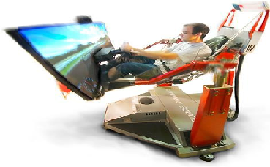
9. Simulation
A representation of a problem, situation, etc. in mathematical terms, using a computer is called simulation.
Computer Simulation is the process of mapping the real-world scenarios into mathematical model using computer graphics.
Recently computer graphics is widely used to create simulated environment.
E.g.; Robot Operation Simulation, Pilot Training, Military Training etc.

Slide 15
10. Cartography
Cartography is the study and practice of designing maps using computer graphics.
Computer graphics is used to produce both accurate and schematic representations of geographical and other natural phenomena from measurement data.
Examples include geographic maps, exploration maps, for drilling and mining, oceanographic charts, weather maps etc.

Slide 16
Advantage of Computer Graphics
A high quality graphics displays of personal computer provide one of the most natural means of communicating with a computer.
It has an ability to show moving pictures, and thus it is possible to produce animations with computer graphics.
With computer graphics use we can also control the animation by adjusting the speed, the portion of the total scene in view, the geometric relationship of the objects in the scene to one another, the amount of detail shown and so on.
The computer graphics also provides facility called update dynamics. With update dynamics it is possible to change the shape, color or other properties of the objects being viewed.
With the recent development of digital signal processing (DSP) and audio synthesis chip the interactive graphics can now provide audio feedback along with the graphical feedbacks to make the simulated environment even more realistic.

Slide 17
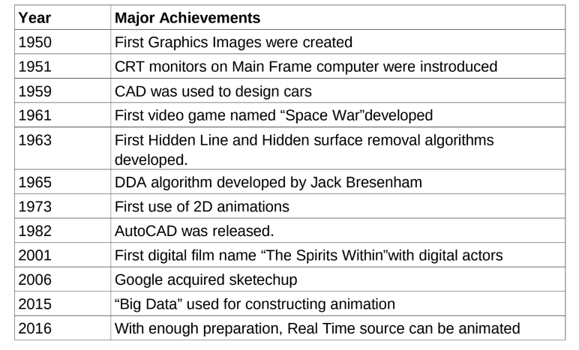
Brief History of CG

